Slide 1
Six Sigma Process
The Gap

Slide 2
Necessary Steps
Defining the problems to be fixes using a high-level roadmap.
Measuring the performance of the current process.
Analyzing the problem to get to the root cause of the problem(Go Lean Six Sigma, n. d).
Improving the system using holistic and elegant solutions.
Controlling the system to ensure sustainability of gains.
Notes:
The team outlines the procedure to fix the problem and use it to get insight into the needs of the customers.
The problem is measured to collect data on the starting point of the process and trying to determine the potential causes. Also, the problem is analyzed to determine the root causes of the wastage experienced within the system.
Besides, the system is improved by brainstorming multiple solutions and selecting the best one (Go Lean Six Sigma, n. d). Lastly, the system is controlled to by consistently monitoring it to ensure that iy is working properly.

Slide 3
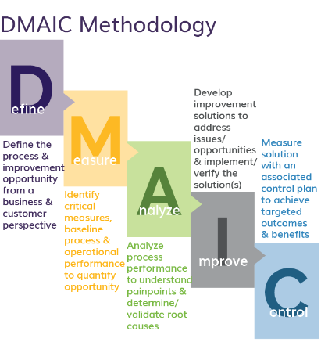
Defects’ Removal
Creating robust design.
Analyzing the effects.
Assessing the reliability and capability of the system to remove the risk.
Enhancing the performance of the system.
Notes:
The system should be strategically planned to ensure that performance levels are maintained and adjusts depending on the customer needs.
The defects should be identified and analyzed to determine its severity as well as the impact on performance. Also, the system should have the capacity to mitigate high-level risks effectively.
Lastly, the team is trained to ensure that the system performs optimally with minimal amounts of input.

Slide 4
Reference
Go Lean Six Sigma, DMAIC- The 5 phases of lean six sigma. Retrieved from
https://goleansixsigma.com/dmaic-five- basic-phases-of-lean-six-sigma/

